Slide 1



PEILab Group Meeting

Slide 2
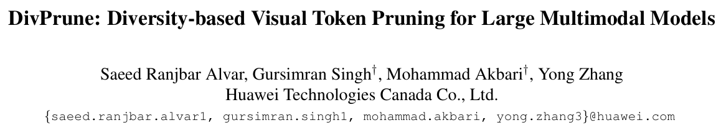
DivPrune
CVPR’25

Slide 3
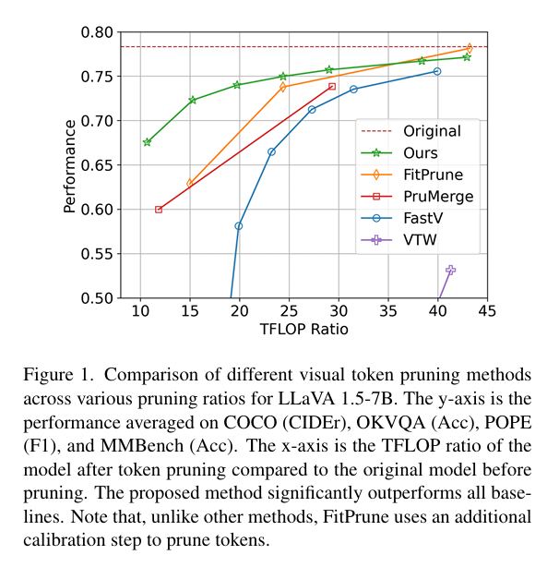
DivPrune
Limitation:
The existing token pruning methods either require extensive calibration and fine-tuning or rely on suboptimal importance metrics which results in increased redundancy among the retained tokens.

Slide 4
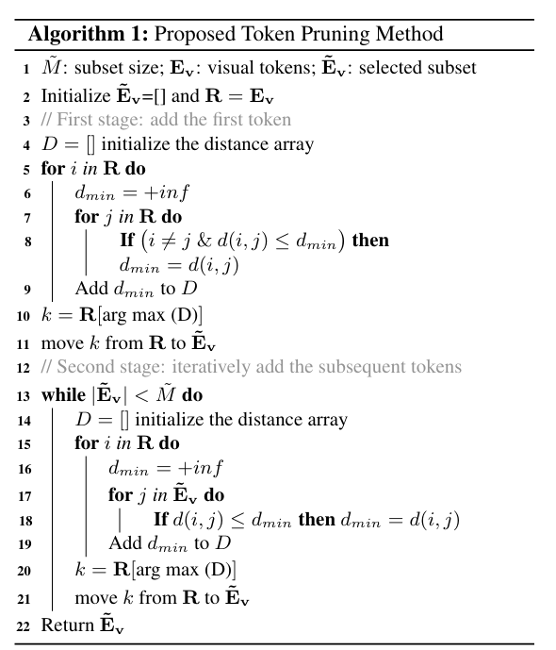
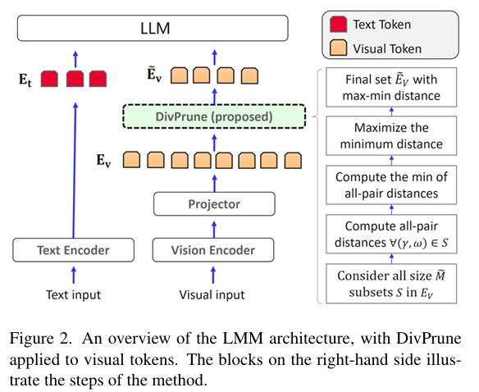
DivPrune
Overview and algorithm

Slide 5
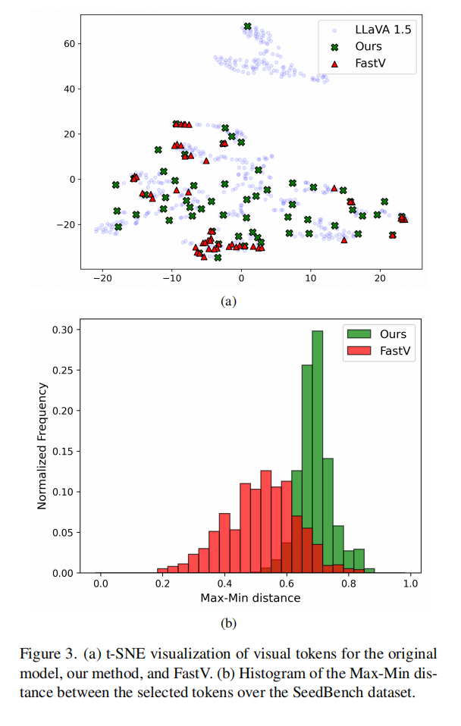
DivPrune
Results
Hence, our method achieves higher diversity among the selected tokens that have less redundancy compared to the ones chosen using FastV.

